Slide 1

AL-FARABI KAZAKH NATIONAL UNIVERSITY
Department of political science and political technologies
Political Cratology
Abzhapparova A.A.
Senior lecturer

Slide 2
Globalization and Development of the Modern World
Lecture 3
History of the formation and development of political thought about power

Slide 3
Lecture plan:
Introduction
Concepts of power
Signs of political power
Functions of political power

Slide 4
Introduction
The phenomenon of power is the most important and most ancient problem of political knowledge, the object of a sharp struggle of ideas in the history of political thought and political theory of modern times. There are many definitions and models of power, but none of them is universal. Despite the different approaches to the problem of power, there are common features and connections. As a result, a relatively holistic doctrine of the most important aspects and manifestations of power is formed.

Slide 5

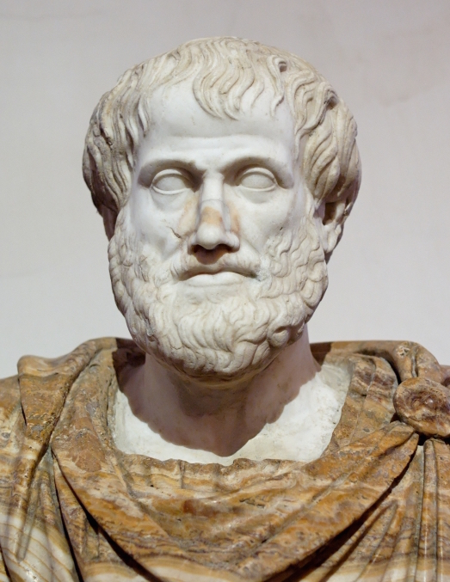
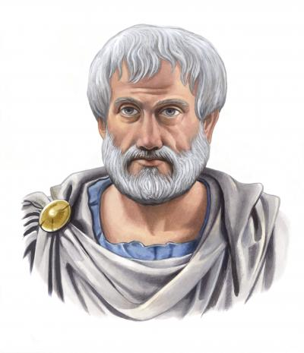
The idea of political power has transformed over time. Thus, attempts to understand political power were made by Aristotle. He described "good" forms of government that excluded the possibility of its selfish use. However, the philosopher identified political power and state power.

Slide 6
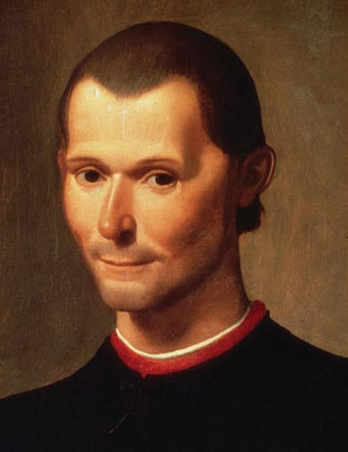
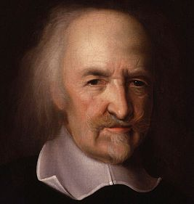
The essence and social nature of political power as state power was substantiated by N. Machiavelli .
The idea of political power and its importance in the life of society was developed by T. Hobbes . The welfare of the people is the highest law of the state. Power is strength, whoever does not have strength, does not have power.

Slide 7
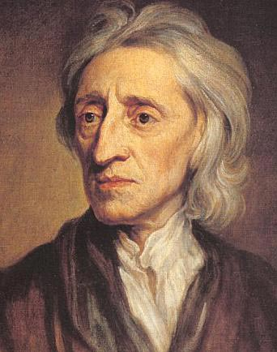
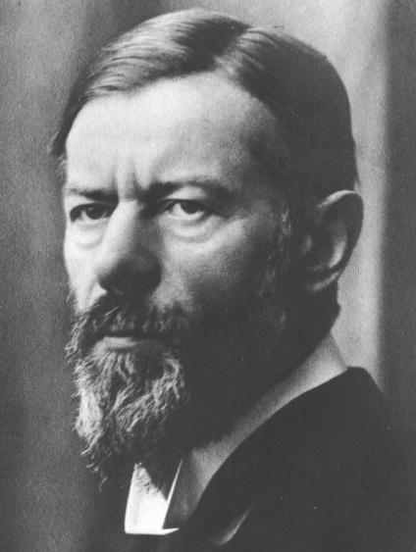
The theory of separation of powers was proposed by D. Locke . Parliament and the government exercise political power as trustees of the people, but they can lose the people's trust.
M. Weber defined: "The main means of politics is violence", but an individual can exercise his will despite resistance. Power must necessarily be based on the principle of legitimacy.

Slide 8
In modern political theory, a number of “internal” and “external” divisions occur between the formal sphere of political power and real practice (the structure of the state and the economic system).

Slide 9
Concepts of power
1) The theological concept of power (A. Augustine) is based on the theory of divine right. The need for power was derived from the thesis of the "natural sinfulness" of man. State power is "divine providence" based on Christian commandments, and monarchs are conductors of divine will. Subordination of people to the principles of divine reason ensures order and self-preservation of society;

Slide 10
Concepts of power
2) Biological concept of power (M. Marcel, F. Nietzsche): power is a mechanism for curbing human aggressiveness, inherent in the instincts of man as a biological being. Power is the will to self-affirmation. The concept formed the basis of A. Hitler's theory regarding the divinely chosen nature of the Aryans, called to rule the world;

Slide 11
Concepts of power
3) The mythological concept of power (L. Duguit) substantiates the idea of the natural origin of power and the division of society into “rulers” and “ruled”, which is due to the physical, moral, religious, intellectual and economic advantage of the ruling class.

Slide 12
Concepts of power
3) Mythological concept of power
To legitimize itself, the government used two myths inherent in two stages of society’s evolution:
in traditional societies the ruler was deified or declared to be the descendant of a deity,
in modern society, the myth of the “public will” is used, which is subordinate to the “individual freedom” of the “strong”;

Slide 13
Concepts of power
4) Behaviorist concept of power
(G. Lassauelle, J. Catlin, F. Hegel):
power as a special type of behavior, when some
People conquer others.
Three “models” of the political process have been proposed:
a) "power model" - "will to power"
b) “market model” – “power is bought and sold”,
c) “game model” – “politics is a theatre and a playing field.”

Slide 14
Concepts of power
5) Psychological concept of power (S. Freud, K. Jung): power is the behavior of real individuals, the origins of which are rooted in the consciousness of people. The desire for power performs the function of subjective compensation for physical or spiritual inferiority;

Slide 15
Concepts of power
6) Systemic concept of power : the existence and production of power depends on the social system. Three approaches of researchers are distinguished:
a) macro approach (T. Parsons, D. Easton) - power is a method and mediator of organizing a political system, a condition for survival and a means of making decisions and distributing values,

Slide 16
b) meso approach (G. Krozie, N. Luhmann) - power is analyzed in relation to the subsystems of society, with its organizational structures, power as a means of social communication, allowing to regulate group conflicts and ensuring the integration of society,
c) micro approach (T. Clark, M. Rogers) – power as the interaction of individuals within the framework of a specific social system.

Slide 17
Concepts of power
7) Teleological concept of power (B. Russell): power is the ability to achieve a set goal, to obtain the intended results;
8) Structural-functional concept of power: power acts as a special type of relationship between subordinates and managers. Society has a hierarchy that differentiates managerial and executive roles.

Slide 18
Concepts of power
9) Relationist concept of power: power is seen as the influence of some people on others. There are 3 approaches to the interpretation of power:
a) “resistance” (D. Cartwright, J. French) - a psychological emphasis in the system of power relations,
b) “resource exchange” (P. Blau, D. Hickson) – sociological emphasis,
c) “distribution of zones of influence” (D. Rong) – political emphasis;

Slide 19
Concepts of power
10) Instrumentalist concept of power : power as the possibility of using certain means, in particular violence and coercion;
11) Conflict theory of power : power as an opportunity to make decisions regulating the distribution of goods in conflict situations;

Slide 20
Concepts of power
12) Conflictological theory of power
(K. Marx, F. Engels, V. I. Lenin): power is considered as a relationship of domination and subordination of one class to another. The nature of domination is determined by economic inequality, the place and role of the class in the economic system of society. Economic inequality is the basis of various forms of social inequality: professional, ethnic, gender, age, regional and cultural.

Slide 21
In modern political science, power is the object of study, which is due to the need for political changes in the power structure of society, the development of the rule of law and the formation of political science.

Slide 22
Signs of political power
1. Political power consolidates the priority of the interests of the subjects of power, which become generally binding for all segments of the population.
2. Authority has a single principle of activity - command, i.e. the right to order, directive, order, law, norm, rules, prohibition, prescription, volitional emotional actions.

Slide 23
Signs of political power
3. Political power contains a contradiction between the subject and the object of power, since power is the ability to subordinate, to influence with the help of certain means. The concentrated expression of power is the relationship of domination - submission, which causes resistance in part of the population.
4. The dominant subject of power has an advantage (status, authority, information, knowledge).

Slide 24
Signs of political power
5. The existence of relationships between subjects, where some possess a certain set of means to ensure the ability to impose their will on others.
6. The sign of political power is objective conditions - relations that determine the volitional actions of people. Behind subjective-volitional relations there is always an objective interconnection, needs and interests of different groups.

Slide 25
Signs of political power
7. At the current stage of development of society, the following are becoming the dominant forms of domination of subjects: political influence, trust, cooperation, stimulation and involvement of the masses in making political decisions.
8. Political power exists and functions in various forms: state, party, regional, international, etc.

Slide 26
The concept of “political power” is broader than the concept of “state power”.
Firstly, political power arose in the pre-state period of development of countries.
Secondly, not every political power is a state power (for example, the power of parties, movements, public organizations), although any state power is always political.

Slide 27
Thirdly, the specificity of state power is that only it has a monopoly on coercion, the right to issue laws, relying on legal institutions and using such means of influence as persuasion, ideological and economic factors.
Fourthly, state power functions on the political-territorial principle; it does not recognize any generic differences, but assigns the population to a specific geographical territory and turns it into its subjects (monarchy) or citizens (republic).

Slide 28
Fifthly, state power is sovereign, that is, supreme, independent, complete and indivisible within state borders and independent and equal in external relations.

Slide 29
State power is the highest form of political power, based on a special administrative and power apparatus and has a monopoly on the issuance of laws, other orders and acts that are binding on the entire population.
Having defined the essence of political power, it is important to pay attention to the principles and functions by which its effectiveness can be judged.

Slide 30
Functions of political power:
1. Development of a strategy for managing society.
2. Development and adoption of detailed decisions on the main directions of society’s development.
3. Operational management and regulation of social processes, including maintaining public order from the standpoint of the interests of certain social groups.
4. Control over the most important parameters of stability and direction of development of society, maintaining its integrity and unity.

Slide 31
Power and politics are inseparable and mutually condition each other. Power is a means of implementing politics. The struggle for power, its acquisition and retention is one of the main aspects of the political life of society.

Slide 32
Power adds to politics that uniqueness, thanks to which it represents a special kind of social interaction. This is due to the unequal position of people included in the hierarchical system of relationships, in the relations of domination - subordination, management - execution.

Slide 33
Without the presence of power relations, it is impossible to coordinate social ties, achieve mutually acceptable compromises between different social communities, strata and individuals, and maintain the integrity and stability of society.

Slide 34
Conclusion
Authority is a system of relations of domination and subordination, the main goal of which is to ensure the implementation of a directive, order, will, etc. with the help of influence, authority, various types of sanctions and direct violence. At the same time, authority is based on generally accepted and legally enshrined in society values and principles that determine and regulate the place, role and functions of a person and social groups in the system of socio-political relations.

